Slide 1
Threat Protection and Detection
6CS029

Slide 2
Todays topics
IPS systems
Taking IPS systems onward to more integrated systems of EDR, XDR etc. Making use of AI and automation
The role of the Security operations centre

Slide 3
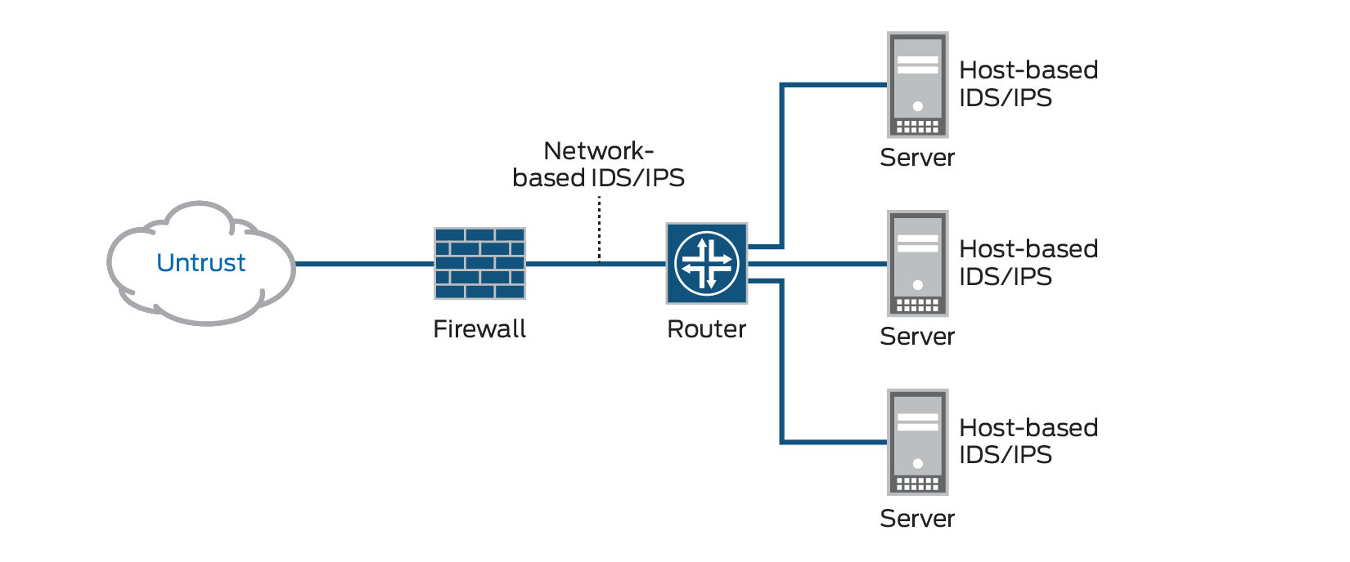
Intrusion Prevention Systems (IPS)
How Does an IPS Work?
An IPS works by analysing network traffic in real-time and comparing it against known attack patterns and signatures. When the system detects suspicious traffic, it blocks it from entering the network.
Can use anomaly detection to identify behaviour that is not that of legitimate users, or signature/heuristic detection to identify known malicious behavior can block traffic as a firewall does, but makes use of the types of algorithms developed for IDSs to determine when to do so

Slide 4
The Role of HIPS
Many industry observers see the enterprise endpoint, including desktop and laptop systems, as now the main target for hackers and criminals
Thus security vendors are focusing more on developing endpoint security products
Traditionally, endpoint security has been provided by a collection of distinct products, such as antivirus, antispyware, antispam, and personal firewalls
Approach is an effort to provide an integrated, single-product suite of functions
Advantages of the integrated HIPS approach are that the various tools work closely together, threat prevention is more comprehensive, and management is easier
A prudent approach is to use HIPS as one element in a defense-in-depth strategy that involves network-level devices, such as either firewalls or network-based IPSs

Slide 5
Host-Based IPS (HIPS)
Can make use of either signature/heuristic or anomaly detection techniques to identify attacks
Signature: Signature firewalls detect threats by matching known malicious patterns (signatures)
Heuristic: identifies threats by analysing behaviours and patterns
Anomaly: iidentify unusual or unexpected activity that deviates from established baselines.
Examples of the types of malicious behavior addressed by a HIPS include:
Modification of system resources
Privilege-escalation – OS vulnerabilities, phising attacks
Buffer-overflow exploits – overwriting data in memory
Access to e-mail contact list

Slide 6
HIPS
A set of general purpose tools may be used for a desktop or server system
Some packages are designed to protect specific types of servers, such as Web servers and database servers
In this case the HIPS looks for particular application attacks
Can use a sandbox approach
Sandboxes are especially suited to mobile code such as Java applets and scripting languages
HIPS quarantines such code in an isolated system area then runs the code and monitors its behaviour
Areas for which a HIPS typically offers desktop protection:
System calls and
File system access
System registry settings
Host input/output

Slide 7
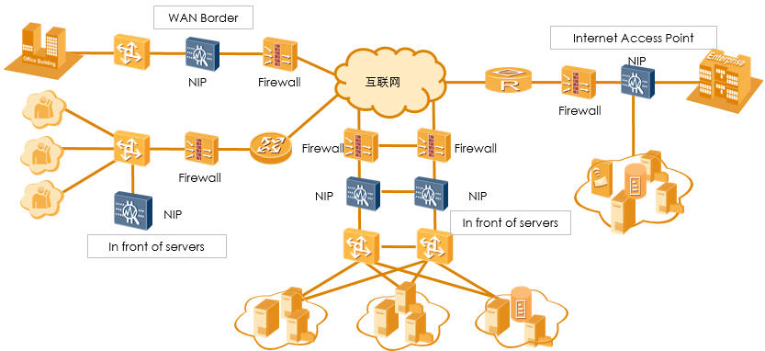
Network-Based IPS (NIPS)
Inline NIPS with the authority to modify or discard packets and tear down TCP connections
Makes use of signature/heuristic detection and anomaly detection
May provide flow data protection
Requires that the application payload in a sequence of packets be reassembled

Slide 8
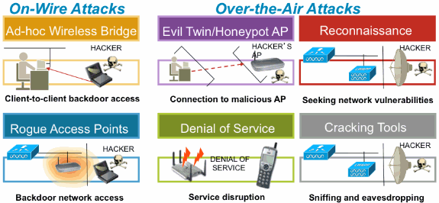
Wireless IPS
monitors wireless network protocols for suspicious activity:-
unauthorized users and devices accessing the company's wifi. If a WIPS detects an unknown entity on a wireless network, it can terminate the connection.
A WIPS can also help detect misconfigured or unsecured devices on a wifi network
intercept man-in-the-middle attacks, where a hacker secretly spies on users' communications.

Slide 9
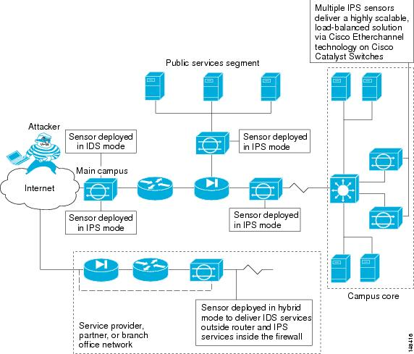
IPS sensors in the network
Always positioned behind a perimeter-filtering device, such as a firewall or adaptive security appliance.

Slide 10
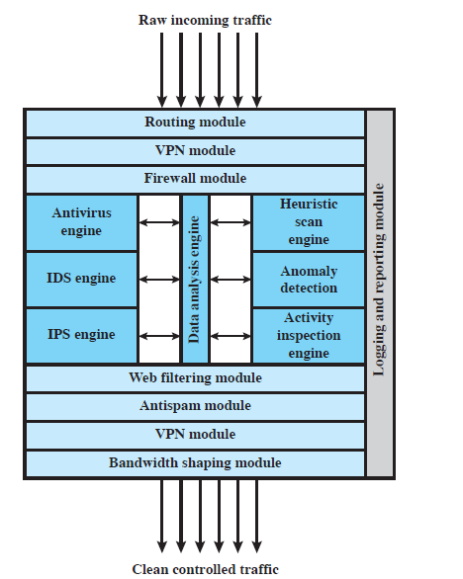
Unified Threat Management Appliance – Combination of all the network security tools Deployed at point of Egress and Ingress

Slide 11
Trends in 2026
Latest trends in cybersecurity threats
Latest trends in 2026

Slide 12
Moving to Automation and Alert Analysis
Cyber attacks become more sophisticated with time and the use of AI in executing these and defending against is going to escalate
Studies estimate that as many as 90% of successful cyberattacks and 70% of successful data breaches originate at endpoint devices.
Antivirus, anti-malware, firewalls, and other traditional endpoint security solutions have evolved over time, they're still limited to detecting known, file-based, or signature-based endpoint threats.
Much less effective at stopping social engineering attacks, such as phishing messages. Phishing is the most common delivery method for ransomware.
Ineffective against a growing number of 'fileless' cyberattacks that operate exclusively in computer memory to avoid file or signature scanning altogether. Fileless attacks
The process of Automation and the need
Ref - https://www.ibm.com/topics/edr

Slide 13

Security Operations Centre
Moving towards automation and a full professional service
centralised function within an organisation employing people, processes, and technology to continuously monitor and improve it’s organization's security posture while preventing, detecting, analysing, and responding to cybersecurity incidents.
May be in the organisation or part of a managed system from a specialist cyber company
Teams of specialist take on roles such as
Engineers - build out and manage the organization's security architecture
Analysts – Tier 1, 2 and 3 depending on the importance of the alert/threat/incident etc
detect, investigate, and triage (prioritize) threats, and identify impacted hosts, endpoints, users etc.
Threat Hunters – following perceived weaknesses to shore up the defences.

Slide 14
What else does a SOC do?
SOC activities and responsibilities fall into three general categories –
Preparation
Asset inventory – need an exhaustive list of all software and hardware, and the tools used to protect them.
Preventative maintenance - updating patches, software, firewall rules, whitelists, blacklists, security policies and procedures.
Backups – in the event of ransom ware etc
Planning
developing the organization's incident response plan, which defines activities, roles, responsibilities in the event of a threat or incident
Prevention
Regular testing -vulnerability assessments – comprehensive assessments that identify each resource's vulnerability to potential threats, and the associate costs.
penetration tests that simulate specific attacks on one more systems.
remediates or fine-tunes applications, security policies, best practices and incident response plans based on the results of these test
Notes:
Routine maintenance and preparation. To maximize the effectiveness of security tools and measures in place, the SOC performs preventative maintenance such as applying software patches and upgrades, and continually updating firewalls, whitelists and blacklists, and security policies and procedures. The SOC may also create system back-ups – or assist in creating back-up policy or procedures – to ensure business continuity in the event of a data breach, ransomware attack or other cybersecurity incident.
Incident response planning. The SOC is responsible for developing the organization's incident response plan, which defines activities, roles, responsibilities in the event of a threat or incident – and the metrics by which the success of any incident response will be measured.
Regular testing. The SOC team performs vulnerability assessments – comprehensive assessments that identify each resource's vulnerability to potential threats, and the associate costs. It also conducts penetration tests that simulate specific attacks on one more systems. The team remediates or fine-tunes applications, security policies, best practices and incident response plans based on the results of these tests.

Slide 15
Endpoint Detection and Response
It achieves detection and responding by end points in the network primarily by continuous monitoring
records and stores endpoint-system-level behaviours,
uses various data analytics techniques to detect suspicious system behaviour
provides contextual information,
blocks malicious activity,
provides remediation suggestions to restore affected systems.
It does this by collecting and aggregating data from endpoints and other sources
EDR explained

Slide 16
eXtended Detection and Response
XDR integrates security tools across an organization’s entire hybrid infrastructure –endpoints, networks, email, applications, cloud workloads – Holistic view.
Extends the tools of Network Detection and Response and EDR
Correlated incidents- collects and correlates alerts, creating a more complete picture of a security incident or attack and allowing analysts to invest time in more focused research.
Analytics - examine large swathes of data coming in from multiple sources—identities, endpoints, email, data, networks, storage, Internet of Things, and applications—strong analytics are essential to understanding threat activity.
Automated detection and response XDR automatically identifies, assesses, and remediates known threats in real time, and can reduce and simplify an organization’s workload, as well as catch hard-to-detect threats.

Slide 17
XDR continued
AI and machine learning - makes it scalable and efficient. From behaviour detection and alerts to investigation and remediation, XDR uses AI to monitor threatening behaviour and automatically respond to and mitigate possible attacks. With machine learning, XDR can create profiles of suspicious behaviour, flagging them for analyst review.
Auto-healing of affected assets XDR returns affected assets to a safe state by enacting healing actions like terminating malicious processes, removing malicious forwarding rules, and identifying compromised users in an organization’s directory.
XDR explanation

Slide 18
overview of what NDR, EDR etc
https://www.youtube.com/watch?v=z983AM8etCA

Slide 19
User Behaviour Analytics and User Endpoint Behaviour Analytics
Recording and analysing user behaviour looking for anomalous patterns
May come from a rogue employee or a hacked account etc.
Lots of logs of users activities are recorded, and the UBA tool correlates, distils and analyses them, and then gives them a ranking
Is user logging in from a geographically different place
is the frequency of what they do dramatically changing
Are they doing something statistically/operationally different to what their peers are doing
Are they changing their behaviour dramatically
Apply the same principles to switches, routers etc.
User Behaviour Analytics

Slide 20
Security Information Event Management
Software tool used in SOC to aggregate logs, EDR, NDR, XDR etc outputs. Then use them to extract information.
Logs – from across the network and using AI, ML and then analyse them for threats and ignore those that do not
Threat Intelligence – data supplied from various sources on current, past and potential threats is analysed to see if it’s relevant to the organisation
Security Events Corelation – looking for patterns in the data that could indicate a threat
Threat hunting – analyse old data to see if new threats that have emerged have not affected the organisation previously
Forensics – data kept for at least 1 year so that if the system is breached you can analyse to see how, when and where
Dashboard to display this
SIEM and SOC

Slide 21
Managed SOC
Only a large organisation can afford to have the necessary highly skilled staff and tools for a SOC – outsourcing
Many companies offer this – Microsoft, IBM, Cisco etc
Security Operations Centre

Slide 22
Summary
Intrusion prevention systems
Host-based IPS
Network-based IPS
Distributed or hybrid IPS
Snort inline
Security Operations Centres and their tools to make them effective
EDR, NDR, UDA, XDR, SIEM

